Slide 1
AE Hackathon AR.Drone 2.0 Workshop
11/5/16
Presenters: Evan Hammac, Zsolt Kira, Ph.D.

Slide 2
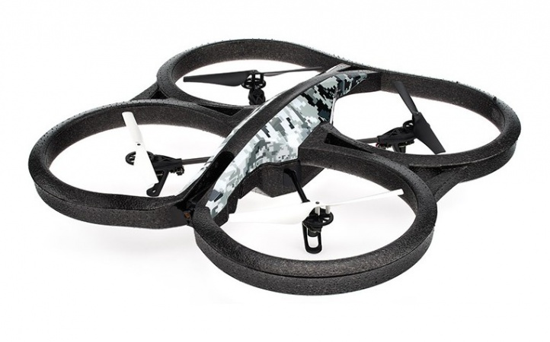
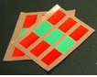
Objectives of Workshop
Task: Make AR Drone track a detected tag
Getting Started:
Download and Install Preconfigured Virtual Machine
Fly AR.Drone Using Keyboard Controller on the Virtual Machine
Goals:
Brief Overview of ROS and its Capabilities
Demonstrate Capabilities of hacking code found on the Virtual Machine

Slide 3
Downloading and Installing the Virtual Machine
First: Google “Up and flying with the AR drone and ROS”
Link: http://robohub.org/up-and-flying-with-the-ar-drone-and-ros-getting-started/
The tutorials found here are detailed instructions for everything to do with installing and updating the virtual machine.
There is a catch however…

Slide 4
Downloading and Installing the Virtual Machine
The tutorial has not been updated in quite some time and the link for the .ova file times out
Google “Mike Hamer github” and click the first link
Click the repository “ardrone_tutorials_getting_started”
Scroll down and click the hyperlink “virtual machine image”

Slide 5
Downloading and Installing the Virtual Machine
This download is quite large
In the meantime let’s download VirtualBox
Once image file is downloaded refer back to “Up and Starting with AR drone…. Webpage”
Follow the steps and verify command and control of AR.drone
The examples uses the Robot Operating System (ROS) framework
To run: roslaunch ardrone_tutorials keyboard_controller.launch

Slide 6
ROS Overview
Large number of robotics groups using Robot Operating System (ROS)
Like an OS, provides basic functionality used commonly in robotics
Nodes ingest input data, process it, and push out data
Messaging system (publish/subscribe) mechanism
Transformations
Logging and debugging
Visualization of sensor data/robot
Simulation
Lots of stacks built on top of this: Mapping, perception, planning, navigation, controls, drivers to hardware
Slides by Alec Poitzsch

Slide 7
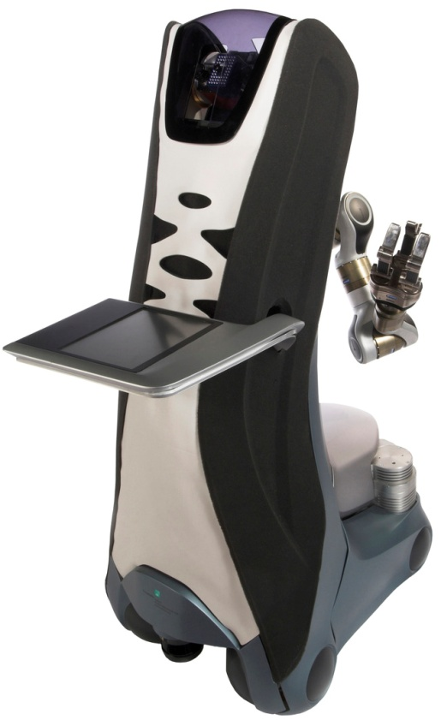
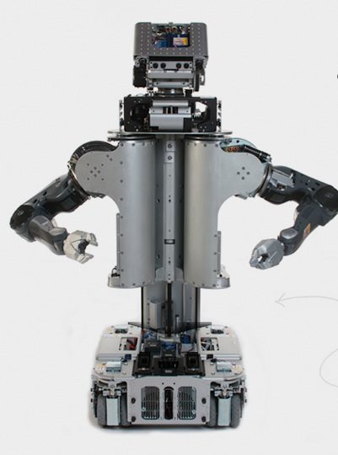
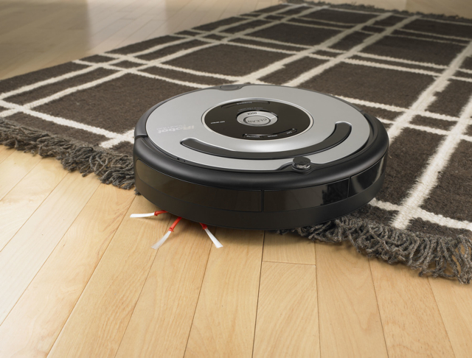
ROS: Reusable code!
PR2 Roomba Care-O-bot 3
Slides by Alec Poitzsch

Slide 8
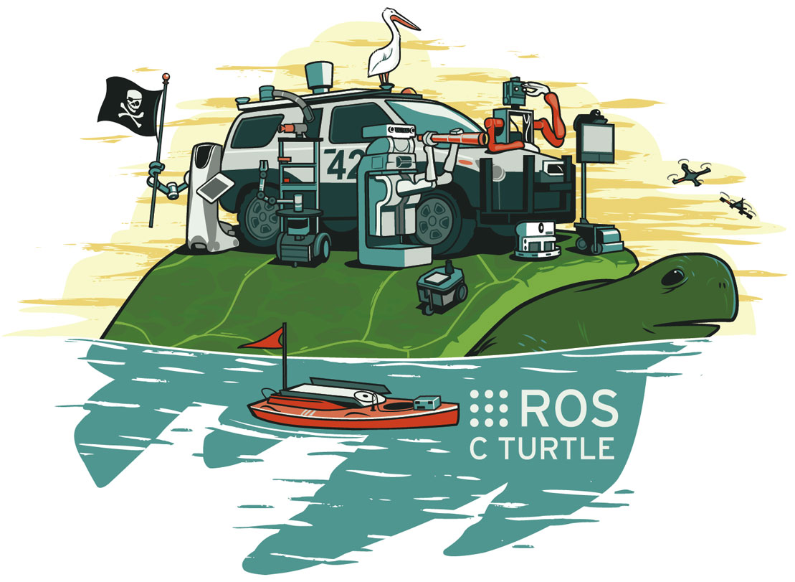
A meta-operating system for robots
Slides by Alec Poitzsch

Slide 9
Comparison: the PC ecosystem
Standardized layers
System software abstracts hardware
Applications leverage other applications (such as database, web server).
Widely existent sets of libraries
Applications
Application building blocks
System software
Hardware
Slides by Alec Poitzsch

Slide 10
Comparison: the robotics ecosystem
Applications
Applications
Application building blocks
ROS
System software
Hardware
Hardware
Slides by Alec Poitzsch

Slide 11
What is ROS?
A “Meta” Operating System.
Open source
Runs in Linux (esp. Ubuntu)
Ongoing Windows implementation
Agent based (nodes)
Message passing
Publish
Subscribe
Services via remote invocation
Supports numerous programming languages (C++, Python, Lisp, Java)
Slides by Alec Poitzsch

Slide 12
What is ROS?
Low level device abstraction
Joystick
GPS
Camera
Controllers
Laser Scanners
…
Application building blocks
Coordinate system transforms
Visualization tools
Debugging tools
Robust navigation stack (SLAM with loop closure)
Arm path planning
Object recognition
...
Application building blocks
ROS
System software
Slides by Alec Poitzsch

Slide 13
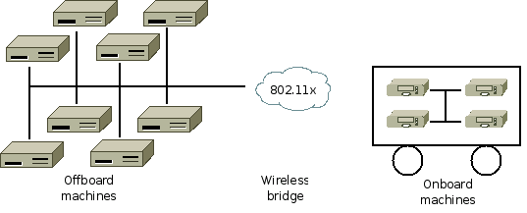
What is ROS?
Software management (compiling, packaging)
Remote communication and control
Slides by Alec Poitzsch

Slide 14

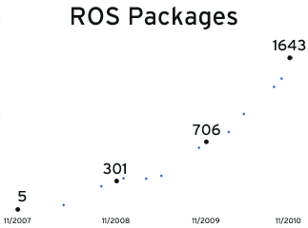
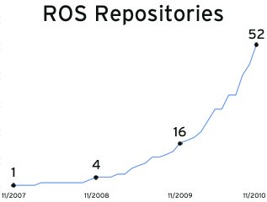
What is ROS?
Founded by Willow Garage
Exponential adoption
Countless commercial, hobby, and academic robots use ROS (http://wiki.ros.org/Robots)
Slides by Alec Poitzsch

Slide 15
ROS Philosophical goals
“Hardware agnosticism”
Peer to peer
Tools based software design
Multiple language support (C++/Java/Python)
Lightweight: runs only at the edge of your modules
Free
Open source
Suitable for large scale research and industry
Slides by Alec Poitzsch

Slide 16



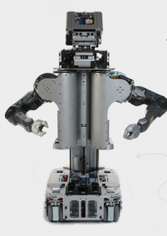

Conceptual levels of design
(A) ROS Community: ROS Distributions, Repositories
Carnegie Mellon
Node 4
Node 5
(B) Computation Graph: Peer-to-Peer Network of
ROS nodes (processes).
Node 1
Laser Scanning
Node 2: Map Building
Node 3: Planning
Node 6
Node7
(C) File-system level: ROS Tools for managing source code, build instructions, and message definitions.
16
Slides by Alec Poitzsch
Notes:
(A) Community Level: Resources that enable separate communities to exchange software: (i) ROS Distributions (ii) Code Repositories (Willow Garage, MIT) (iii) Wiki (B) Computation Graph Level: Peer-to-Peer network of ROS processing that are processing sensor data and doing other computations. Nodes can be distributed across machines (C) Filesystem Level: Ros has lots of tools for (i) organizing source code (ii) simplifying build instructions / dependencies (iii) Managing message definitions

Slide 17
Tools-based software design
Tools for:
Building ROS nodes
Running ROS nodes
Viewing network topology
Monitoring network traffic
Many cooperating processes, instead of a single monolithic program.
Slides by Alec Poitzsch
Notes:
(A) No Monolithic Runtime Environment (B) Small tools for building + running ros nodes: visualizing network topology, measuring bandwidth utilization, plotting.

Slide 18
Multiple language support
ROS is implemented natively in each language.
Quickly define messages in language-independent format.
C++ Node : Map Building
Python Node:
Laser Scanner
Subscription
Publication
Topic: “LaserData”
File-system level
Header header
Points32[] pointsXYZ
int32 numPoints
Slides by Alec Poitzsch
Notes:
(A) ROS implemented natively in each target langauge. (B) Language-independent Interface Definition Language (IDL) for defining messages:

Slide 19
Lightweight
Encourages standalone libraries with no ROS dependencies:
Don’t put ROS dependencies in the core of your algorithm!
Use ROS only at the edges of your interconnected software modules: Downstream/Upstream interface
ROS re-uses code from a variety of projects:
OpenCV : Computer Vision Library
Point Cloud Library (PCL) : 3D Data Processing
OpenRAVE : Motion Planning
ROS Community
Carnegie Mellon
Slides by Alec Poitzsch
Notes:
Get downstream data, produce upstream data.
(A) Would like modules to be re-usable outside of ROS. Encourage all algorithm development to occur in standalone libraries w/ no dependencies on ROS. Don’t put ROS in your algorithm. (B) ROS re-uses code from a variety of projects: OpenCV, Point Cloud Library, OpenRAVE (ish). ROS just routing data in/out of respective software with as little wrapping as possible.

Slide 20
Peer to Peer Messaging
No Central Server through which all messages are routed.
“Master” service run on 1 machine for name registration + lookup
Messaging Types:
Topics : Asynchronous data streaming
Parameter Server
Computation Graph
Slides by Alec Poitzsch
Notes:
The ROS runtime "graph" is a peer-to-peer network of processes. No Central Server: Contrast w/ central-server-based Carmen: Consider the case of running robot w/ off-board compute-intensive tasks. If we run a central server offboard (or even onboard: go thru both cases) this results in unnecessary traffic across (slow) wireless link: many message routes are fully contained in subnets either onboard or offboard. Peer-to-peer connectivity avoid this issue Master : DNS / name service : register + find nodes. Nodes connect to other nodes directly; the Master only provides lookup information, much like a DNS server. Nodes that subscribe to a topic will request connections from nodes that publish that topic, and will establish that connection over an agreed upon connection protocol. The most common protocol used in a ROS is called TCPROS, which uses standard TCP/IP sockets. Styles of communication: *Asynchronous streaming of data over topics, and storage of data on a Parameter Server. 3rd type: synchronous RPC-style communication over services → we don’t really use

Slide 21
Peer to Peer Messaging
Master: Lookup information, think DNS
roscore command → starts master, parameter server, logging
Publish: Will not block until receipt, messages get queued.
Delivery Guarantees: Specify a queue size for publishers: If publishing too quickly, will buffer a maximum of X messages before throwing away old ones
Transport Mechanism: TCPROS, uses TCP/IP
Bandwidth: Consider where your data’s going, and how
Slides by Alec Poitzsch
Notes:
TCPROS is a transport layer for ROS Messages and Services. It uses standard TCP/IP sockets for transporting message data. Inbound connections are received via a TCP Server Socket with a header containing message data type and routing information.

Slide 22
Free & Open Source
BSD License : Can develop commercial applications
Drivers (Kinect and others)
Perception, Planning, Control libraries
MIT ROS Packages : Kinect Demos, etc
Interfaces to other libraries: OpenCV, etc
Slides by Alec Poitzsch

Slide 23
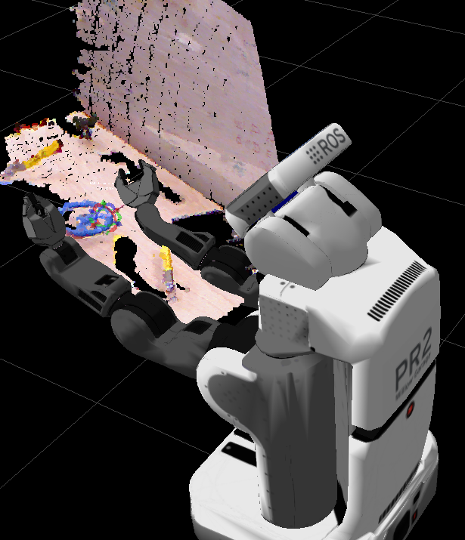
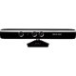
ROS Debugging
Shutdown “Object” node → re-compile → restart : won’t disturb system
Logging (VIDEO)
Kinect Driver
Object Recognition
Laser Scanner
Logger
Playback (VIDEO)
Logger Playback
Object Recognition
23
Slides by Alec Poitzsch
Notes:
Editing Software: Say you want to debug 1 node in a large 20-node system. You can start all 20 nodes. Then if you want to change the 1 node you’re interested in: you can shut it down while leaving the other 19 running. You can re-code, re-compile, and re-launch that node. The ros infrastructure (graph / master name registration) will automatically adapt to nodes dropping out / activating. (B) Logging: Can dump any message stream to disk without modifying source code.
Logging/Playback: Recall your simulation environment in Labs

Slide 24
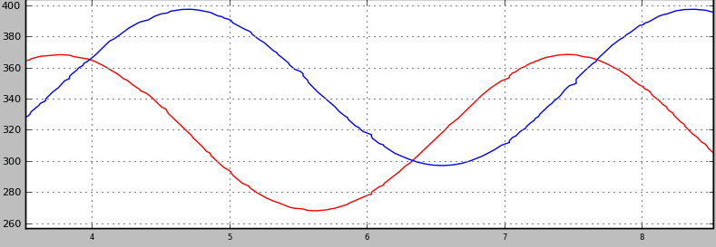
Useful ROS Debugging Tools
rostopic: Display debug information about ROS topics: publishers, subscribers, publishing rate, and message content.
rostopic echo [topic name] → prints messages to console
rostopic list → prints active topics
… (several more commands)
rxplot : Plot data from one or more ROS topic fields using matplotlib.
rxplot /turtle1/pose/x,/turtle1/pose/y → graph data from 2 topics in 1 plot
Slides by Alec Poitzsch
Notes:
Rxplot: Rotation angle of the wheels/ Encoder reading
Rostopic: What if you don’t know if your encoders are being read correctly, or if your motor died ( how does the robot know it is not responding )
DEBUGGING tools

Slide 25
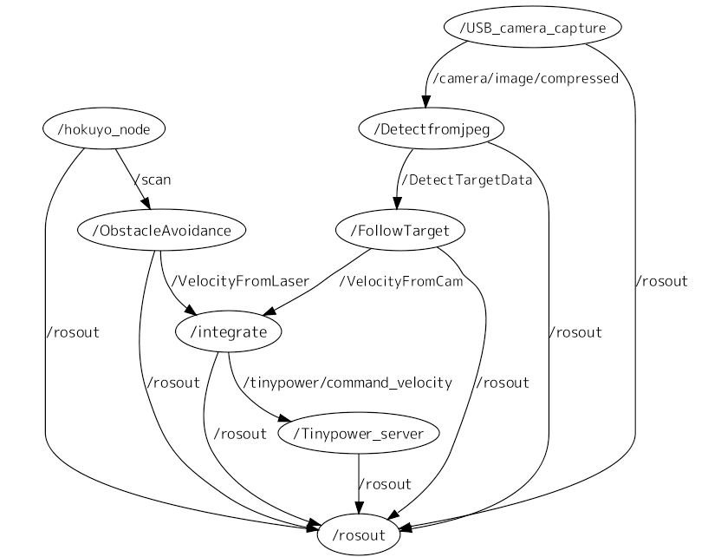
Useful ROS Debugging Tools
rxgraph
Slides by Alec Poitzsch

Slide 26
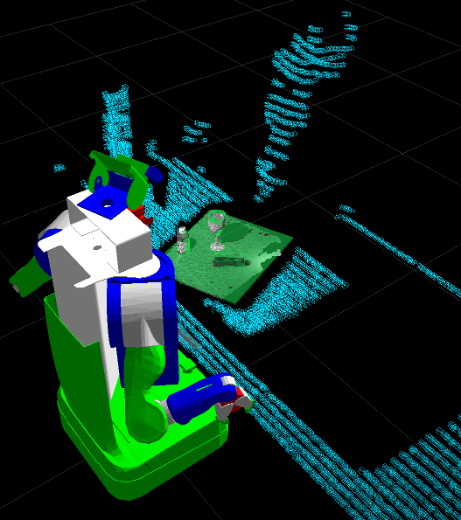
ROS Visualization
Visualize:
Sensor data
Robot joint states
Coordinate frames
Maps being built
Debugging 3D markers
VIDEO
Slides by Alec Poitzsch
Notes:
(A) rviz (demo): tap into any message stream and visualize (if plugin available) Demo will show visualization of point clouds, robot joint states, coordinate frames, user-added markers

Slide 27
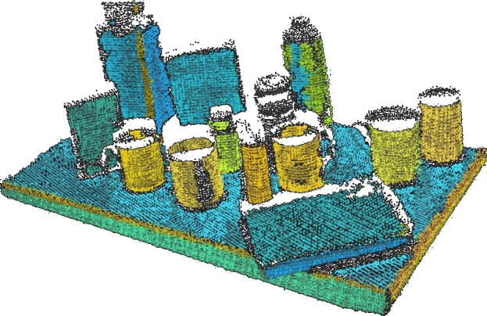
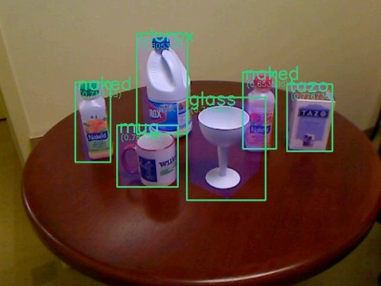
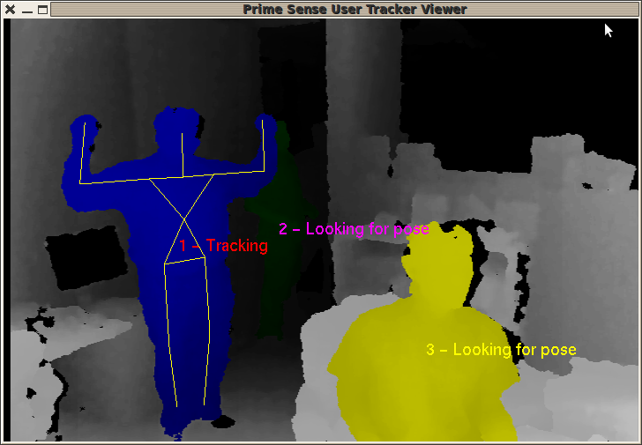
Packages
Perception
Point Cloud Library (PCL)
OpenCV
Kinect/OpenNI
Slides by Alec Poitzsch

Slide 28
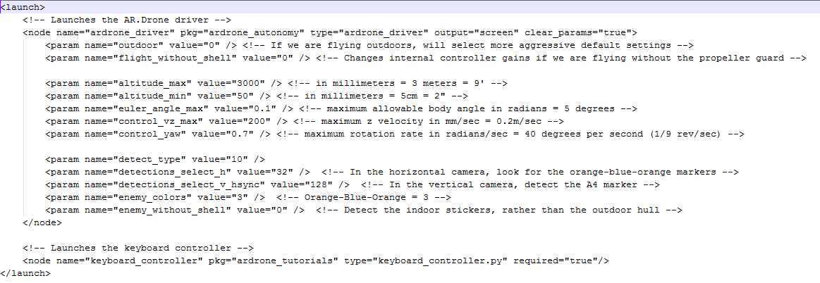
Back to Example: Launch files
roslaunch ardrone_tutorials keyboard_controller_with_tags.launch
ardrone_autonomy\src\ardrone_driver.cpp
ardrone_tutorials\src\keyboard_controller.py

Slide 29
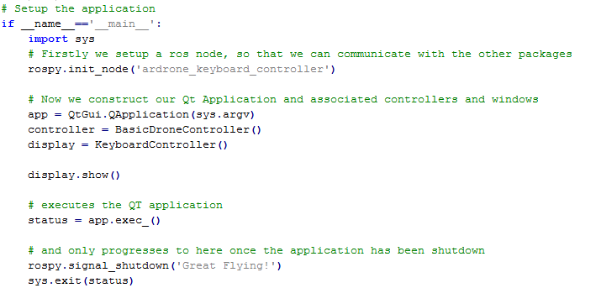
Example
ardrone_tutorials\src\keyboard_controller.py

Slide 30
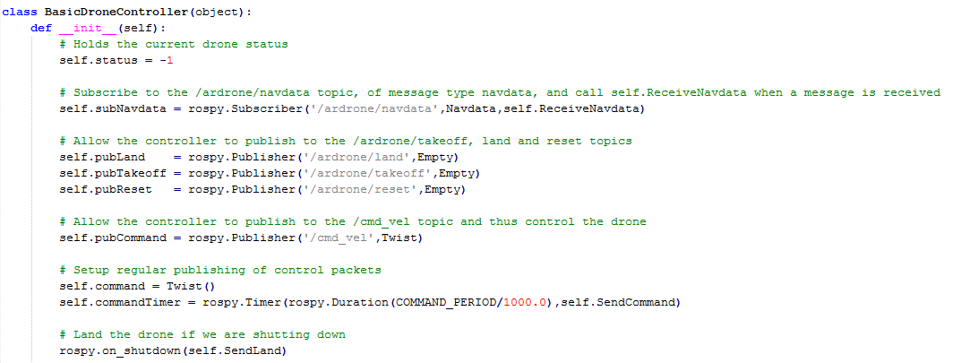
Example
ardrone_tutorials\src\drone_controller.py

Slide 31
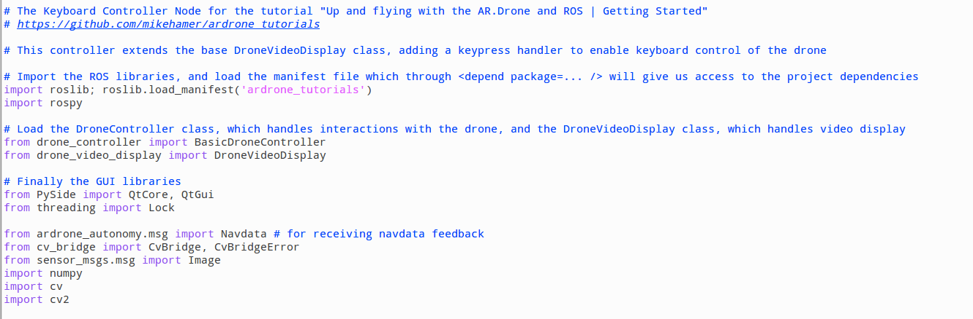
Example
Making modifications to the keyboard_controller.py file makes for a simple way to implement custom behaviors
Here we show some imports

Slide 32
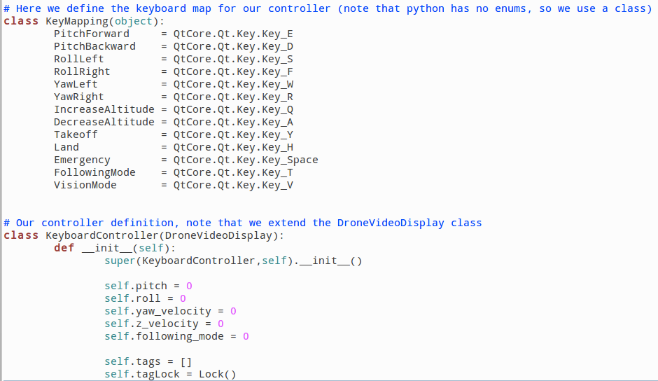
Example
Here we see our definitions for specific behaviors.
Here you can see our two behaviors on our chosen keys (feel free to choose your own)
ardrone_tutorials\src\keyboard_controller.py

Slide 33
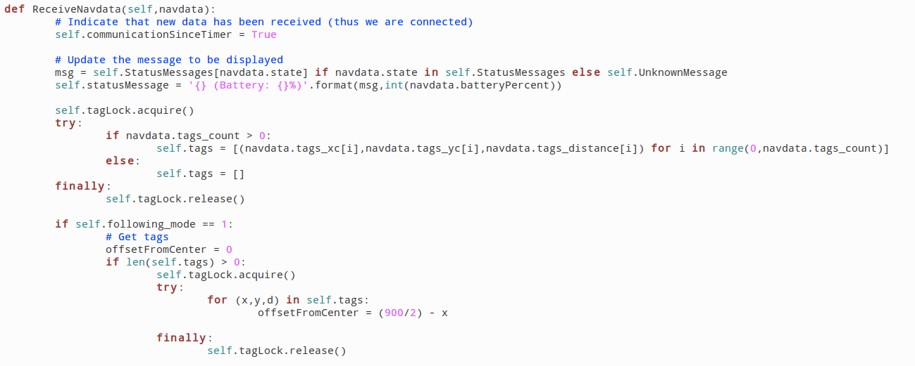
Example
Here we insert the first of our vision processing code.

Slide 34
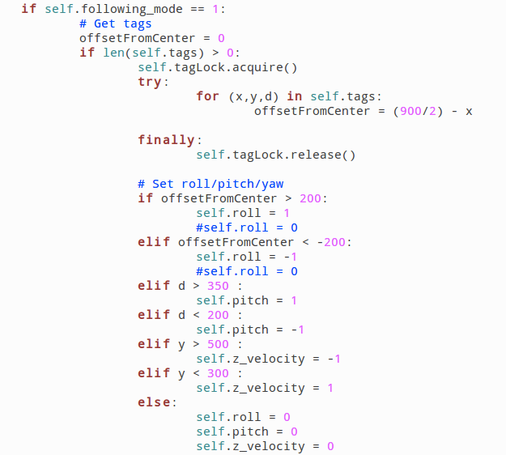
Example
Now we start to develop behaviors and bounds for that behavior

Slide 35
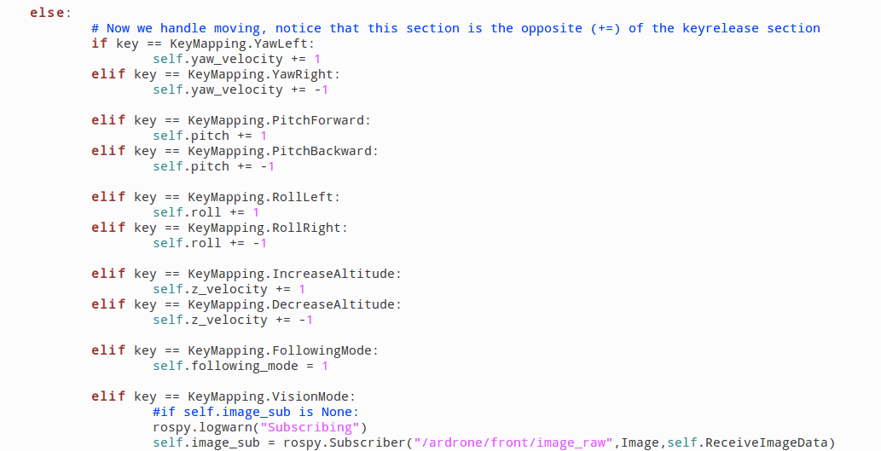
Example
Now we use the key depress/release states to exhibit our wanted behavior (this is the depress code)

Slide 36
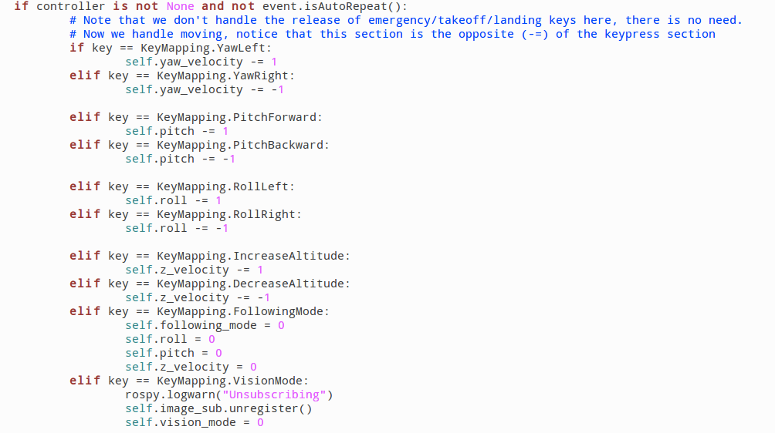
Example
Now we modify the key release section of code

Slide 37
Example
Now we can test the behaviors ☺

Slide 38
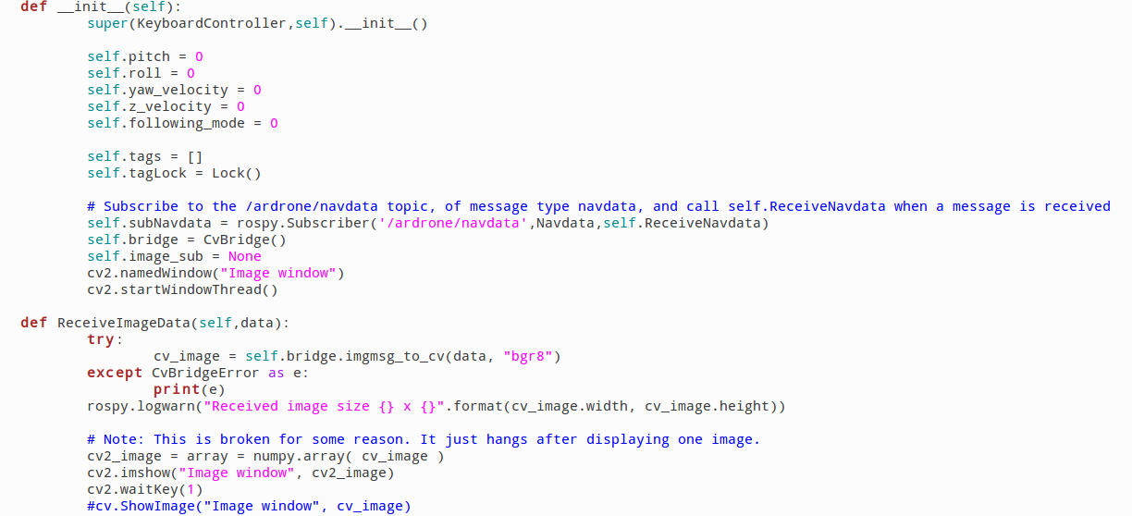
Example
This is the OpenCV image processing portion of the code, brushed over this earlier.

Slide 39
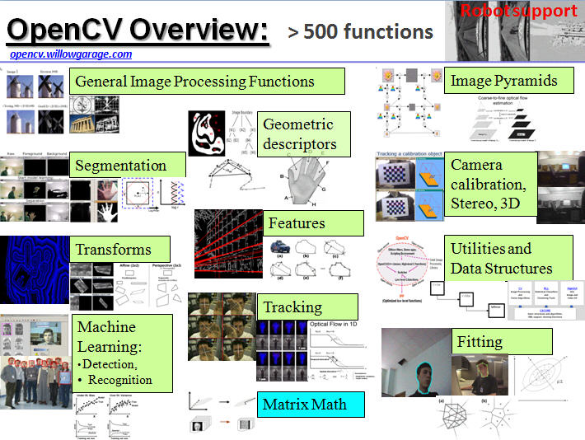
OpenCV
OpenCV is a great resource for manipulating images. We leave it open to you to decide what you would like to create!

Slide 40
Some Ideas…
Easy: Proportional-Integral-Derivative (PID) controller: Smoother motion

Slide 41
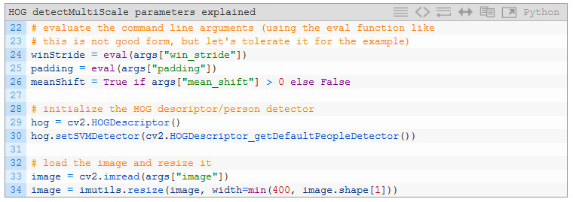
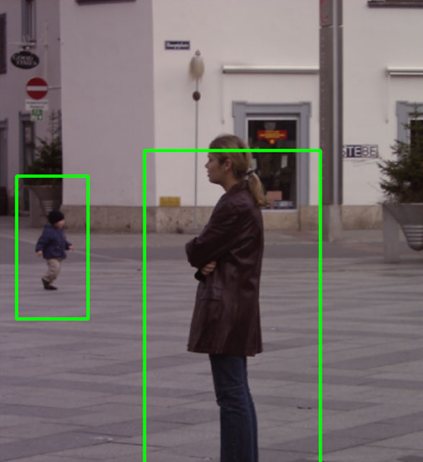
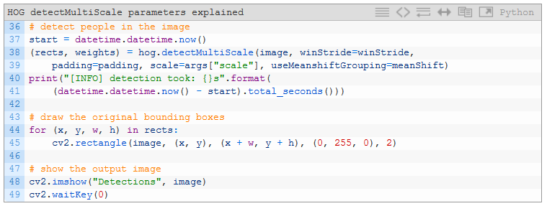
Some Ideas…
Easy: Proportional-Integral-Derivative (PID) controller: Smoother motion
Medium: OpenCV Person Detection + Following
http://www.pyimagesearch.com/2015/11/16/hog-detectmultiscale-parameters-explained/

Slide 42
Some Ideas…
Easy: Proportional-Integral-Derivative (PID) controller: Smoother motion
Medium: OpenCV Person Detection + Following
Hard:
Your own color histogram (e.g. hand) detector
Deep-Learning Based Object Detection & Following
Visual odometry: Re-trace steps after piloting

Slide 43
In Closing
Please see me for the download of the python file that we made modifications to.
Be careful: Test code gently (low velocities or just debug outputs without action first!)
Have a safety person watching it besides pilot!
Best of luck to all the teams!
Thanks to everyone involved in the AE Hackathon for hosting this fantastic event!!

